Slide 1
Blended Learning:
Face-to-Face and Virtual
ELT Classrooms
Pupung Purnawarman
1st NaCoLET, UMC
11 September 2021

Slide 2




Slide 3
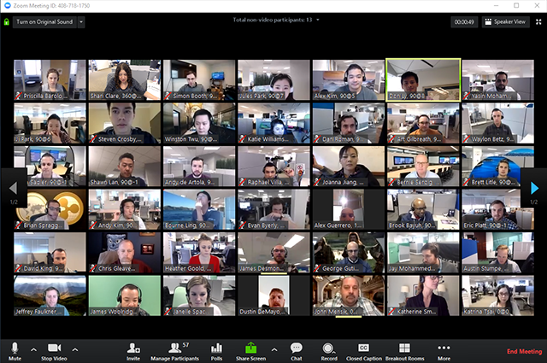

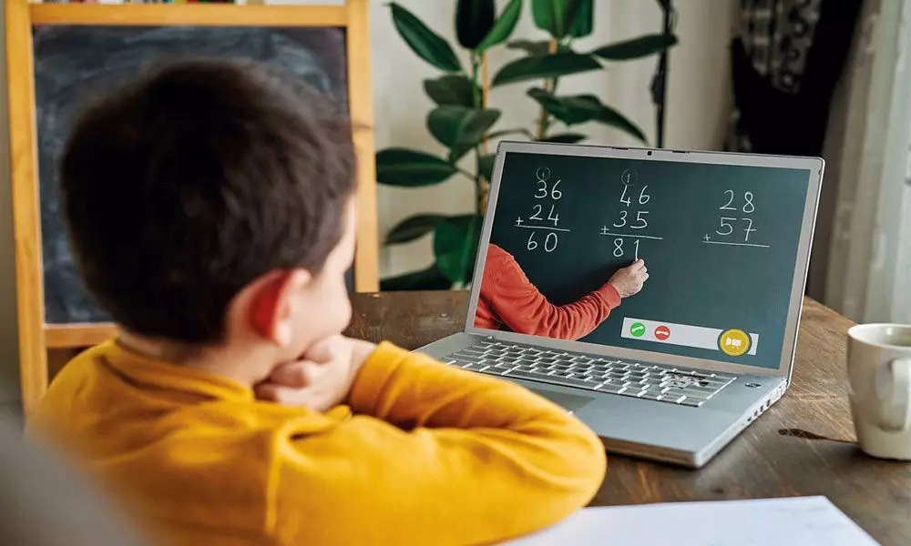

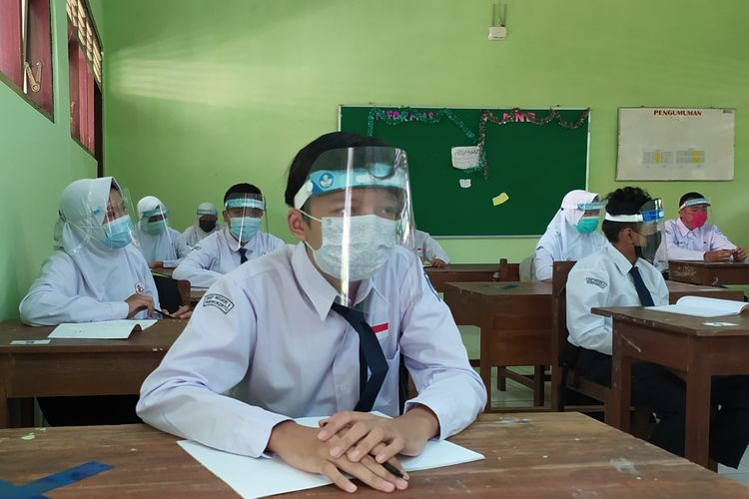
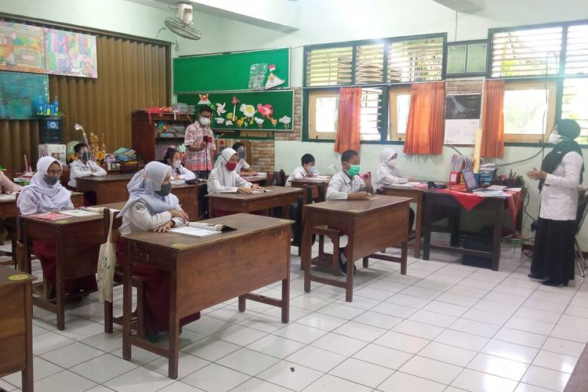

Slide 4
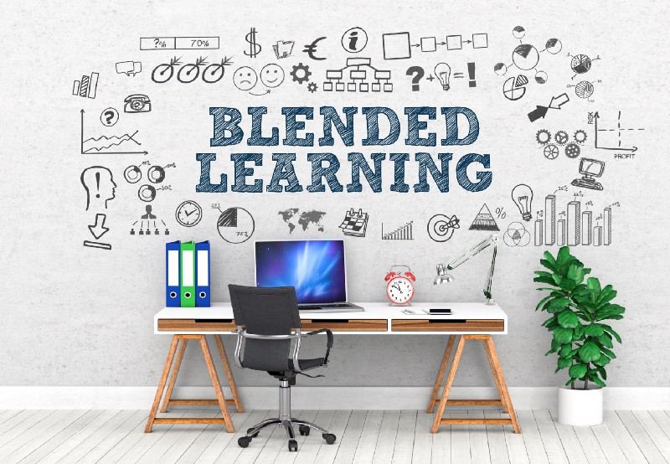

Slide 5
Blended Learning
What is Blended Learning?
Some definitions
A way of studying a subject that combines being taught in class with the use of different technologies, including learning over the internet. (Oxford Dictionary)
A style of education in which students learn via electronic and online media as well as traditional face-to-face teaching (Oxford Dictionary)

Slide 6
Blended Learning
An approach to learning that combines face-to-face and online learning experiences. (teachthought.com)
An approach to education that combines online educational materials and opportunities for interaction with traditional place-based calssroom methods requiring physical presence of both teacher and student. (learnupon.com)

Slide 7
Blended Learning
Blendedlearning.org
In part online, with some elements of control over the their learning.
In part in a brick-and-mortar location away from home.
The modalities along a student’s learning path are connected to provide an integrated learning experience.

Slide 8
Blended Learning
In the online part of the blended learning setting, students have some elements of control over the time, place, path, or pace of their learning.
Students can decide when to learn, how to do it, to pause, go back, skip, or move forward.
Students are not always dependent on the teacher (not always real time).
Activities can be synchronous or asynchronous.

Slide 9
Blended Learning
In the F2F part, students attend the physical class with teachers.
Students meet and can collaborate with other students to have an integrated learning experience.
Students can discuss and consult with their teachers on what they will have to do during the online part or to have clarification or confirmation on what they have learned during their online part prior to the F2F session.

Slide 10
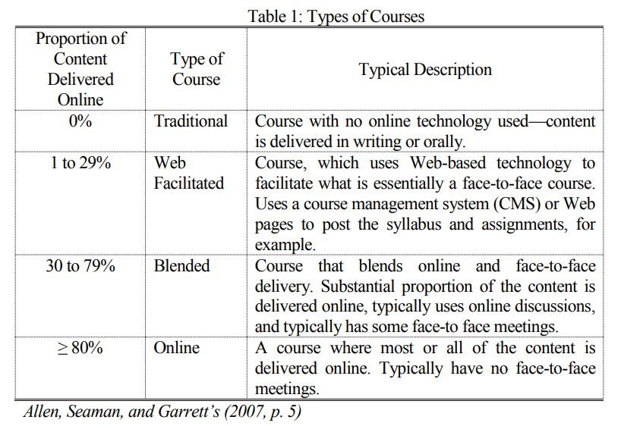
Proportion of Blended Learning

Slide 11

Face-to-Face Learning
What is Face-to-Face Learning?
Teaching a group of students learning materials and course content by the instructional method.
There is a live interaction between the teacher and the student.
Students can interact and learn from each other. (teachmint.com)

Slide 12
Face-to-Face Learning
Teacher-centered or student-centered method.
It involves traditional classroom learning.
Students attend classes daily.
Teacher and students meet in a set place, a set time.
(headspace.org.au , colleges.co.za)

Slide 13
Virtual Classroom
What is Virtual Classroom?
A digital learning environment that allows teachers and students to connect in real time.
It utilizes video conferencing, online whiteboards and screen sharing tools.
It allows teachers to teach live lectures and have discussions with students in an interactive setting. (tophat.com)

Slide 14
Virtual Classroom
A VC refers to an online system that allows students and teachers to communicate and collaborate.
It is usually cloud-based and a part of LMS.
It is usually to replicate the experience of physical classrooms + added benefits of file sharing, instant feedback and interaction.
It is accessible on a variety of devices (desktop, laptop, tablet, smartphone, etc.).

Slide 15
Virtual Instruction
A method of teaching that is taught entirely online or when elements of F2F learning are taught online through LMS or other educational tools or platforms.
A form of blended learning where students are exposed to learning materials online on their own before class.
F2F class time is then usually focused on interactive learning activites.

Slide 16
ELT in Blended Learning Settings
Teaching English using a blended learning approach requires careful planning.
It is not merely combining F2F and online learning for technology sake.
Planning the design process of ELT is very important.
BL takes more time to plan: prepare multiple activities that will appeal to students’ English learning preferences and abilities.

Slide 17
ELT in Blended Learning Settings
EL teachers need to prepare learning materials far in advance and consider their compatibility with the online learning environment and devices.
EL teachers must consider the language skills (receptive and productive) to be facilitated appropriately and proportionally.
To be effective, EL teachers must be provided with technology training and must be adaptable to new, various technology.

Slide 18
ELT in Blended Learning Settings
EL teachers need to focus more on the curriculum, learning objectives, and students’ needs with the help of technology—technology comes later .
EL teachers must carefully plan how and in what forms the assessesments will be given, and how feedback will be provided for students to reach learning objectives.
EL teachers must carefully consider the proportion of F2F, synchronous and asynchronous sessions.

Slide 19
ELT in Blended Learning Settings
Schools and policy makers should facilitate EL teachers with the required infrastructures for the implimentation of Blended Learning.
Schools and policy makers must make sure that teachers are provided with proper training (technology and methodology).
Schools and policy makers must make sure students have access to Blended Learning.

Slide 20
Effective Blended Learning for ELT
A comprehensive LMS
A comprehensive LMS is very vital for creating an immersive language learning environment.
It can function as a central repository of information: course material, assignments, web resources, etc.
It must be open for access and use to all students
Elearningindustry.com

Slide 21
Effective Blended Learning for ELT
A well-defined course outline
From the very beginning, teachers must prepare a definite course outline to guide learners.
Teachers must lay out course content and structure and the tools to be employed for instruction.
The course outline should include course resources, objectives, assignment details, assessments, and their grading percentage.
Elearningindustry.com

Slide 22
Effective Blended Learning for ELT
Clear learning objectives
Teachers must identify and define clear learning objectives to help students understand what they can expect from a course.
An effective blended learning classroom mandates a definite understanding of course goals before educators start creating content.
The objectives serve as a roadmap that will help students understand where learning is headed and the topics that need to be covered to successfully achieve course objectives.
Elearningindustry.com

Slide 23
Effective Blended Learning for ELT
Good communication
Effective communication between the teacher and students needs to be established to achieve improved learning outcomes.
There should be an adequate exchange of queries and feedback with regular classroom discussions.
Teachers can provide their contact information and encourage students to communicate in case of questions and concerns.
Toward the end of a course, they can also engage learners in live or online surveys, evaluations, and opinions on the quality of the course and its delivery.
Providing regular and constructive feedback is an important element of effective communication.
Elearningindustry.com

Slide 24
Effective Blended Learning for ELT
A well-trained teacher
A blended learning course requires proper teacher training to facilitate optimal learning.
Teachers must understand student needs and design the course accordingly.
As blended classrooms can be difficult to plan and manage, teachers must also be trained in management strategies tailored for such classrooms.
They must be well-trained with the technology required to execute blended learning, including training on software and hardware management.
Elearningindustry.com

Slide 25
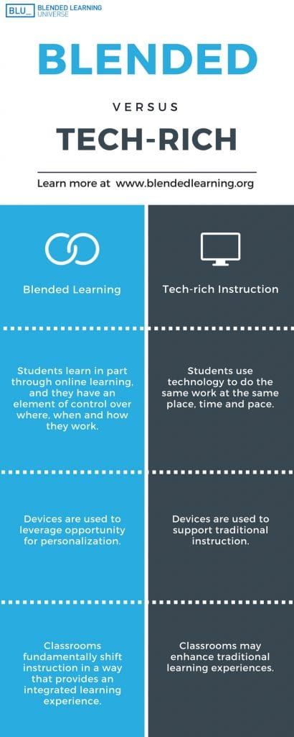

Slide 26
Thank You ☺

